Slide 1
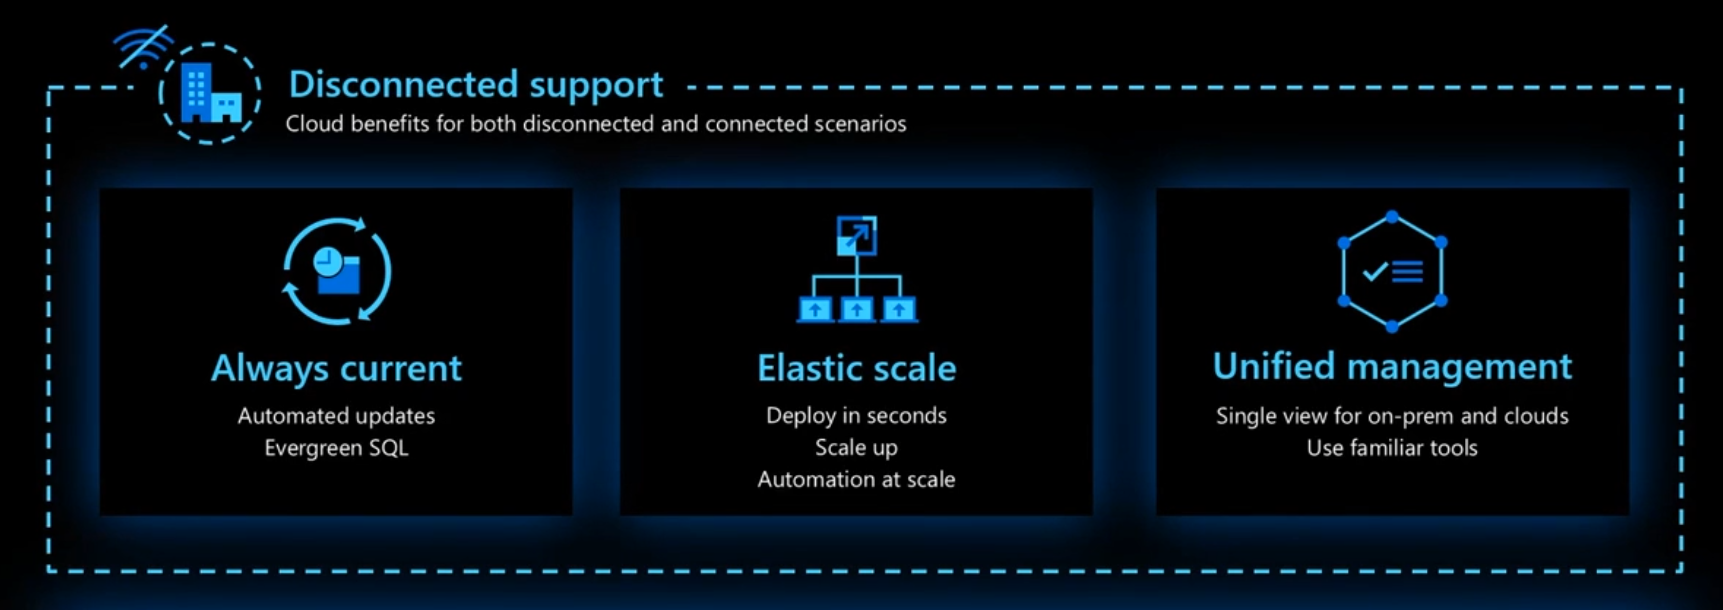




Azure Arc-Enabled Data Services Is Anywhere

Slide 2
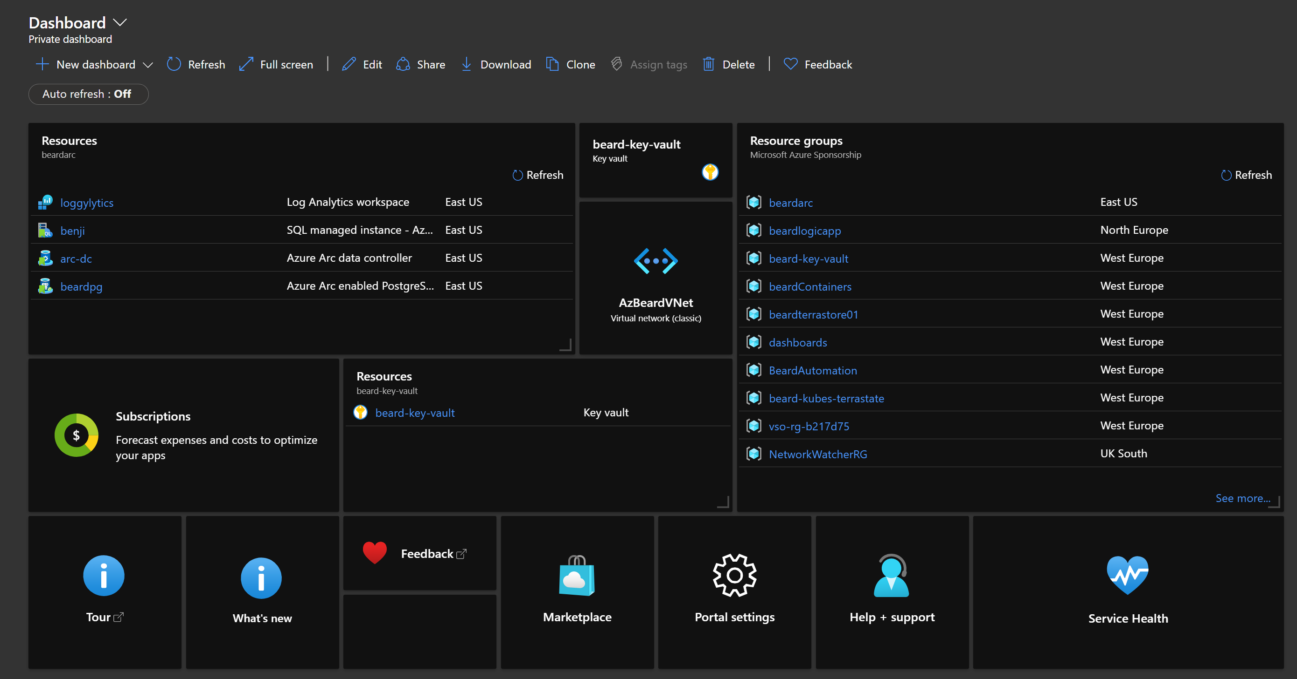
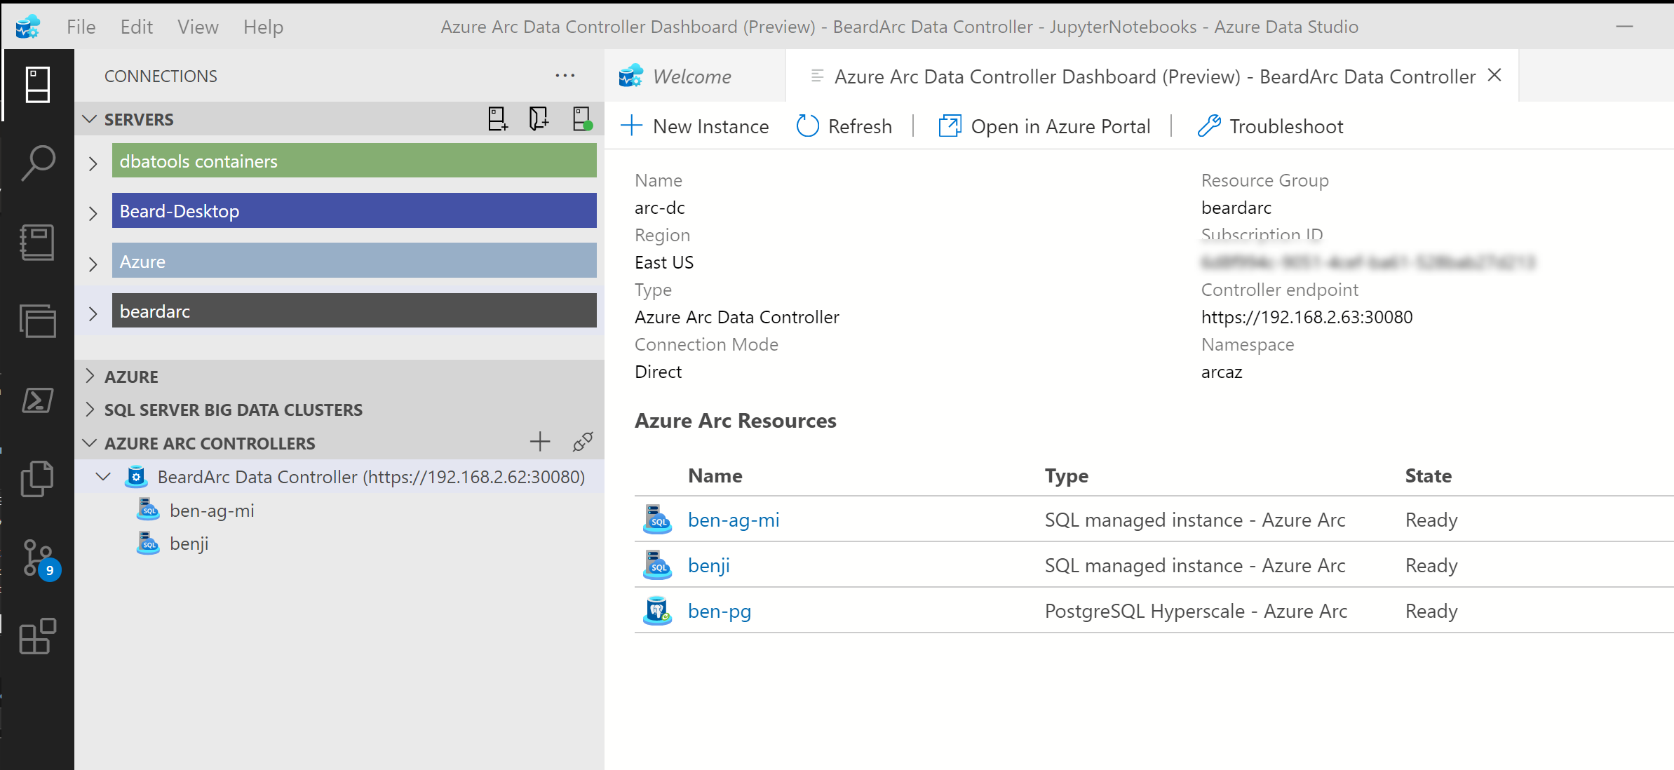
Azure Arc-Enabled Data Services Is Anywhere

Slide 3








The Data Controller
Dashboards
Metrics
Logs
Backup/Restore
High Availability
Provisioning
API
Connectivity Modes
Directly Connected
Indirectly Connected
https://docs.microsoft.com/en-us/azure/azure-arc/data/connectivity
Notes:
Provides dashboards, metrics and logging built in
Controls High Availability, automated backup/restore in the plans
Enables Elastic Scale of CPU, RAM and Nodes for Availability Groups

